Slide 1

UCLA Extension
Google Play Store App Analysis
Group H

Slide 2
MCSS Consulting Group was tasked with providing strategic guidance for a new app – My Chakra Meditation. Business tasked us to look into the various factors that affect their app store rating in order to make this app a success. App - has a Content Rating of “Everyone” (0) and a price of $ 2.99, and user rating 4.3 in the Google Play Store
Factors that affects the app business to be successful
Average of the ratings
Number of reviews (has strong influence in determine app ranks)
Stronger engagement
Retention metrics such as high star ratings have an even stronger influence on pricing the app.

Slide 3
Data scientists requires to study the current app store data in Google play store to achieve our new app to relinquish success. Data scientists are posed with the below questions.
What is the most common user Rating, Content Rating and Price in the app store?
What is the relationship between user Rating and Content Rating, as well as the relationship between user Rating and Price?
What is the average of the Rating and Price of apps in the Google Play Store? What is the most common Content Rating?
How do both Content Rating and Price impact user Rating?

Slide 4
What is the most common user Rating, Content Rating and Price in the app store?

Slide 5
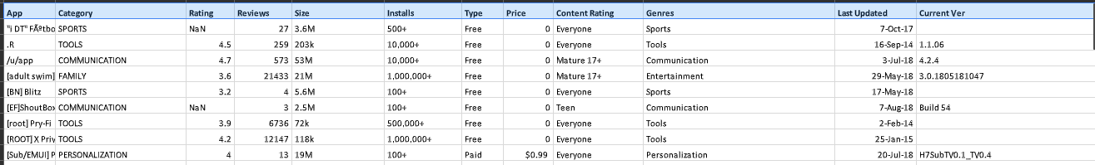
Working with the data
Public data set of Google play store available through web scrapping
Variables
App Name | Category
Rating | Reviews
Size | Installs
Variables
Type | Price
Content of Rating | Genres
Last updated | Current version
Android version

Slide 6
Working with the data
Identify the valid values for the list of variables.
Perform data cleansing such as filling with NaaN values
Format the data into the correct columns
Variable | Type/Values
Category | ART_AND_DESIGN AUTO_AND_VEHICLES BEAUTY BOOKS_AND_REFERENCE BUSINESS SPORTS
Type | Free, Paid
Content Rating | Adults only 18+ Everyone Everyone 10+ Mature 17+ Teen Unrated
Variable | Type/Values
Genres | Action Action & Adventure Auto & Vehicles Beauty Social Sports
Installs | Numeric
Price | $ value range from 0 to 400

Slide 7
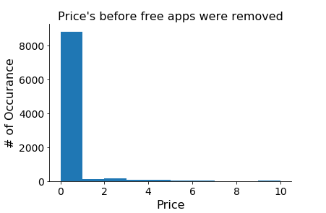
Common user Rating, Content Rating and Price
Price of all apps under 10
Study Distribution of each variables
93% of apps are Free of the charge
In order to find the right price band for the app,
Exclude Free apps to determine the right pricing range for our app

Slide 8
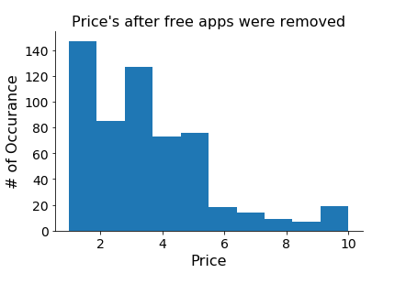
Common user Rating, Content Rating and Price
Price of all apps greater than 0
Validate exclusion of Free apps did not skew the data in Content rating & App rating.
Compare Histograms of Content rating and user rating with free apps and without free apps.
Convert content rating into values for linear regression
Content Rating | Value
Everyone | 0
Mature 17+ | 1
Everyone 10+ | 2
Teen | 3
Unrated | 4
Adult only 18 + | 5

Slide 9
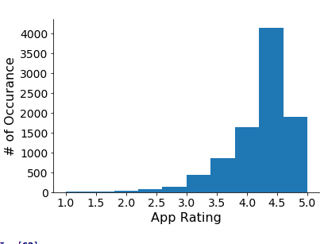
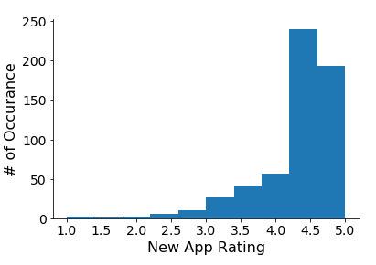
Common user Rating, Content Rating and Price
User ratings(App Ratings) for price under $10
User ratings (excluding free apps)
Histograms of user rating with free apps and without free apps

Slide 10
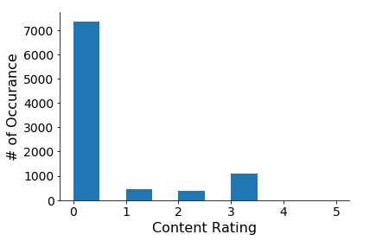
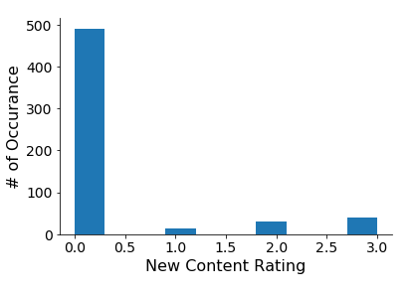
Common user Rating, Content Rating and Price
Content Ratings for all apps under $10
Content ratings (excluding free apps)
Excluded unrated/Adult only 18+ because of less population densities.
Histograms of Content rating with free apps and without free apps

Slide 11
What is the most common user Rating, Content Rating and Price in the app store?
Common user rating: 4.25 to 4.75
Common content rating: Everyone

Slide 12
What is the relationship between user Rating and Content Rating, as well as the relationship between user Rating and Price?

Slide 13
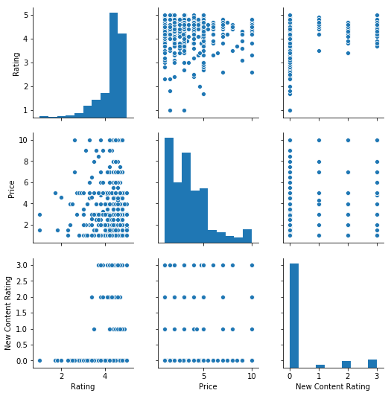
Correlation
Pair Plot
Create a pair plot to understand relationship between variables
Content Rating
User rating
Price
Content rating and Price did not demonstrate a strong relationship with user rating
Data points are thinly spread out with no patterns

Slide 14
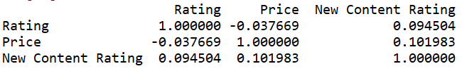
Correlation
Create a pairwise correlation score to check relationship between variables plot to understand relationship between variables
Price and Rating are inversely correlated to each other. Higher price , lower the user rating.

Slide 15
What is the average of the Rating and Price of apps in the Google Play Store? What is the most common Content Rating?

Slide 16
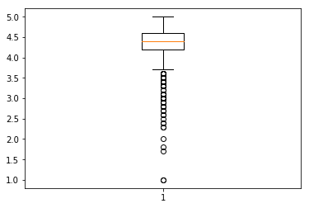
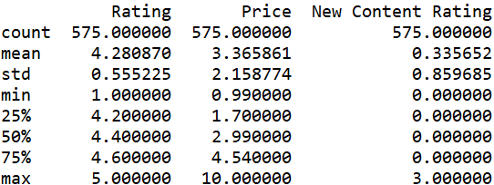
Common user Rating, Content Rating and Price
Box Plot of user ratings of apps under $10
(excluding free apps)
Statistical analysis of the distribution of our variables for apps under $10
(excluding free apps)
Average Rating is 4.28 and Average price is $3.37 explains the appropriate user rating and price range should be targeted for our app to be successful.

Slide 17
How do both Content Rating and Price impact user Rating?

Slide 18
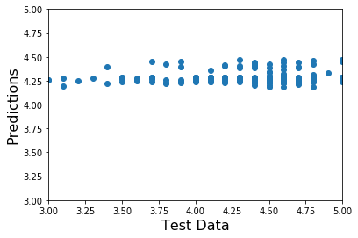
Impact
Test user Ratings vs Predictions
Use Supervised learning approach to investigate how Price vs Content impacts user ratings using linear regression model.
Train the model with 60% of data (with apps under $10, excluding free apps)
Use 40 % of data to test our model.
Model was unreliable in predicting user rating.
Training score – 0.008
Test set score – 0.017

Slide 19
Impact
Test user Ratings vs Predictions
Price nor content rating significant to user rating.
Predicted user ratings against linear regression model resulted in a slope close to 0 instead of 1.
Mean square error (MSE) was 0.26 . Lower the MSE, more accurate the model is.
Predicted user Rating of MyChakra meditation app using the model is 4.25 very close to the actual value of 4.26.
This indicate that our model is similar when trained on Content Rating and Price, user ratings and price.

Slide 20
Recommendations
Common user rating: 4.25 to 4.75
Common content rating: Everyone
Average Rating is 4.28 and Average price is $3.37
Price and Rating are inversely correlated to each other. Higher price , lower the user rating.
Given that the most popular Content Rating is “Everyone”
A popular category is also one that is more saturated with competitors.
Although number of downloads may increase (and potentially sales) being in a popular category with more users, those users also have more apps with which to compare to our stakeholder’s app.

Slide 21
Recommendations
With the current analysis using user ratings, content ratings and price. Neither, content rating nor price will predict accurately the user ratings.
Investigate further with more accurate predictive model by considering other variables that are not considered such as size, Installs, Types, Genres and continue further analysis to investigate the effect of these futures.

Slide 22
